Slide 1
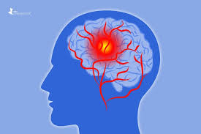
Stroke awareness session
Annie Rea, Occupational Therapist
Claire Murphy, Speech & Language Therapist
Community Stroke Team South Eastern HSC Trust

Slide 2
Contents:
What is a stroke?
Types of stroke
Signs/symptoms of stroke
Hidden effects of stroke
Stroke & work
Caring for someone with a stroke
Advice/support
Questions

Slide 3
Stroke strikes every 5 minutes
Each year around 4,000 people will have a stroke in NI
There are almost 37,000 stroke survivors living in NI
27% of stroke survivors are under 65
Females 45% Males 55%

Slide 4
What Is A Stroke? - YouTube
Notes:
A stroke happens when the blood supply to part of the brain is cut off, killing brain cells. Damage to the brain can affect how the body works. It can also change how you think and feel. The effects of a stroke depend on where it takes place in the brain, and how big the damaged area is.
What causes stroke?
As we age, our arteries become harder and narrower and more likely to become blocked. However, certain medical conditions and lifestyle factors can speed up this process and increase your risk of having a stroke.

Slide 5
Types of Stroke:
There are three different types of stroke:
Ischaemic stroke
Haemorrhagic stroke
Transient ischaemic attack or TIA.
Notes:
An ischaemic stroke happens when a blockage cuts off the blood supply to part of your brain. This is the most common type of stroke. Around 85% of strokes are ischaemic.
A haemorrhagic stroke is caused by bleeding in or around the brain. This is a less common type of stroke – around 15% of strokes are haemorrhagic.
A transient ischaemic attack or TIA is also known as a mini-stroke. It is the same as a stroke, except that the symptoms only last for a short time. This is because the blockage that stops the blood getting to your brain is temporary. With a TIA someone might feel ok afterwards but its vital to get medical help right away. Having a TIA is a warning that you are at risk of having a stroke and the risk if greatest in the first days and weeks after a TIA.

Slide 6
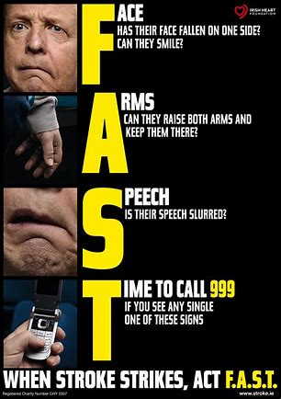
Stroke signs
Notes:
Stroke is a medical emergency. If anyone experiences any of these signs, it is essential to call 999 immediately.
FAST acronym is a test to quickly identify if someone is having a stroke.
F – Face weakness – can the person smile? Has their mouth or eye drooped?
A- Arm weakness – can the person raise both arms?
S – Speech – can the person speak clearly? Can they understand what you say?
T – Time – to call 999 if you see any of these signs.

Slide 7
Other signs of a stroke
Sudden weakness or numbness on one side of the body
Difficulty finding words or speaking in clear sentences
Sudden blurred vision or loss of sight
Sudden memory loss or confusion
Dizziness
Sudden fall
Sudden severe headache
Notes:
The FAST test helps spot the 3 most common symptoms of stroke. But there are other signs that you should always take seriously.
These include:
-sudden weakness of numbness on 1 side of the body, including legs, hands or feet.
-difficulty finding words or speaking in clear sentences
Sudden blurred vision or loss of sight in 1 or both eyes
Sudden memory loss or confusion
Dizziness
A sudden fall
- A sudden severe headache

Slide 8
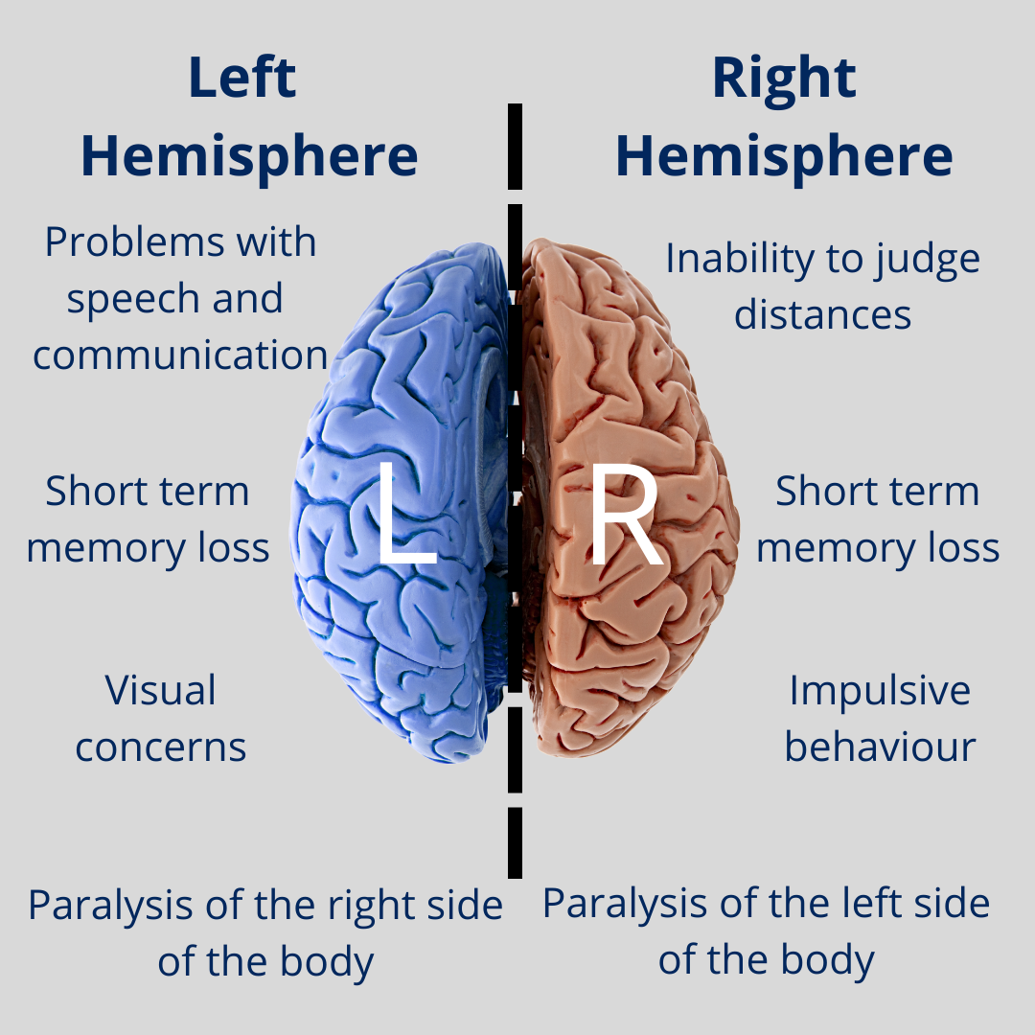
Effects of Stroke
Notes:
Every stroke is unique, but strokes tend to affect people in common ways.
The effects of a stroke depend on several factors, including the location of the obstruction and how much brain tissue is affected. However, because one side of the brain controls the opposite side of the body, a stroke affecting one side will result in neurological complications on the side of the body it affects
Left Brain
If the stroke occurs in the left side of the brain, the right side of the body will be affected, producing some or all of the following:
Paralysis or loss of sensation on the right side of the body
Speech/language problems
Visual problems
Memory loss
Right Brain
If the stroke occurs on the right side of the brain, the left side of the body will be affected, producing some or all of the following:
Paralysis or sensory loss on the left side of the body
Vision problems
Problems with depth perception, judging distances
Memory loss
Impulsive behaviour

Slide 9
Hidden effects of Stroke
Balance difficulties
Emotional changes
Behavioural changes
Problems with memory & thinking (cognitive problems)
Wordfinding difficulties
Information processing
Tiredness/fatigue
Notes:
While some effects of a stroke may be obvious to others, many effects are harder to see and are poorly understood or supported by others. These hidden effects of a stroke can be even more difficult for stroke survivors to live with.
Balance difficulties: a stroke can change the way the brain controls balance and the person can feel unsteady or incoordinated. It might be difficult to walk and talk at the same time.
Emotional changes: most people who’ve had a stroke will experience some kind of emotional change. For many it feels like they’ve lost the life they had before and they experience feelings of shock, denial, anger, grief and guilt. Emotional problems can also be caused by brain damage due to the stroke. Anxiety and depression are common symptoms experienced by stroke survivors. A stroke can affect ability to control mood and emotions e.g. someone may laugh or cry uncontrollably and for no reason.
Behavioural changes: such as apathy/lack if motivation, anger and aggression, being unable to read social situations, acting impulsively, being unable to think decisions through.
Cognitive problems – cognitive skills are how the brain makes sense of, organises and stores information from the outside world. A stroke can affect these brain processes and result in problems with concentration, memory,planning, organisation, problem solving, multi-tasking. 9 out of 10 stroke survivors experience at least 1 cognitive effect.
Language and communication problems – around 1/3 of stroke survivors have problems with speaking, reading, writing and understanding what others are saying. Wordfinding difficulties are very common with stroke – the person may be unable to think of a specific word, or may say the wrong word or mix up the sounds in the words. This can be extremely frustrating. Understanding and processing spoken or written information can also be affected to varying degrees and can affect many everyday activities and situations such as reading a newspaper or a novel, talking on the phone, following a news bulletin.
Fatigue – or extreme tiredness is the most common effect of a stroke. 86 % of stroke survivors experience fatigue and it can be very debilitating. It affects people both physically and cognitively. Unlike normal tiredness it doesn’t get better by simply resting. People find it difficult to find the mental energy required to think or strength to take part in everyday activities.
These hidden effects of stroke do not just disappear. Stroke survivors have to adapt and alter the way they do things to cope.

Slide 10
Stroke & work – a case study
John – 55year old man, senior position in charity organisation
Notes:
Subarachnoid haemorrhage,
OT & Physio & SLT involved
Physio – balance work
SLT – wordfinding, processing of spoken & written information
OT – reduced recall, poor executive skills namely multitasking, complex problem solving, monitoring of tasks
Goal – to return to work.
Cedar – Workable NI involved for support with returning to work.
Impact on work
Was requiring support with language skills for returning to work
Some difficulty with immediate repetition of longer, detailed sentences suggesting auditory memory issues
Difficulties with reading comprehension of documents involving several paragraphs due to poor retention of written information
word-finding delay is still noted in conversation.
Initially word-finding issues evident in written composition task however he reports now able to compose long documents/reports successfully albeit this takes longer than usual.

Slide 11
Caring for someone with a Stroke
Be prepared for changed behaviour.
Try to remain patient and positive.
Make time for yourself.
Ask for help.
Notes:
Caring for somebody after a stroke can be a frustrating and lonely experience. Be prepared for changed behaviour. Someone who’s had a stroke can often seem as though they’ve had a change in personality and appear to act irrationally because of the psychological and cognitive impact of a stroke.
Try to remain patient and positive. Rehabilitation can be a slow and frustrating process. Encouraging and praising any progress, can help motivate someone who has had a stroke to achieve their long-term goals.
Make time for yourself. If you’re caring for someone who has had a stroke, it’s important not to neglect your own physical and psychological wellbeing.
Ask for help. There are a wide range of support services and resources available for people recovering from strokes, and their families and carers

Slide 12
Advice & Support
www.nhs.uk/conditions/stroke/recovery
Stroke Association: www.stroke.org.uk/finding-support/stroke 03033033100
NI Chest Heart & Stroke: www.nichs.org.uk
02890320184

Slide 13
Any questions?

Slide 14
Thankyou

